Slide 1
Loops Script
Linux

Slide 2
Introduction
Loop scripts are fundamental constructs in programming and scripting that enable the execution of a sequence of code repeatedly. They provide a way to automate tasks that need to be performed multiple times without writing the same code over and over. Loop scripts play a crucial role in making programs efficient, concise, and capable of handling repetitive operations.
Loop scripts are particularly valuable when you have to iterate through a collection of data, perform calculations, or execute a certain set of instructions multiple times. There are several types of loop scripts, with the two most common types being the "for loop" and the "do-while loop."

Slide 3
Scripting Fundamentals
Scripting is a fundamental technique in computer programming that involves writing sequences of commands in a specific scripting language to automate tasks or manipulate data. Loops are a crucial component of scripting, allowing you to repeat a set of instructions multiple times. They play a significant role in making scripts efficient, versatile, and capable of handling a wide range of scenarios.

Slide 4
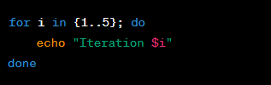
For Loop Script
A ‘for’ loop is used to repeatedly execute a block of code a specified number of times. It's particularly useful for iterating over sequences like numbers or elements in an array.
Example:

Slide 5
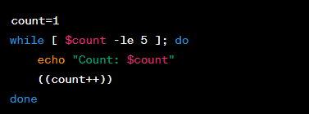
Do-While Script
A do-while loop executes a block of code repeatedly as long as a specified condition is true. The code block is executed at least once before the condition is evaluated.
Example:

Slide 6
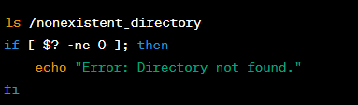
Exit Status
Exit status indicates the result of the last executed command in a script. It's a numeric value that signifies whether the command executed successfully (exit status 0) or encountered an error (non-zero exit status).
Example:

Slide 7
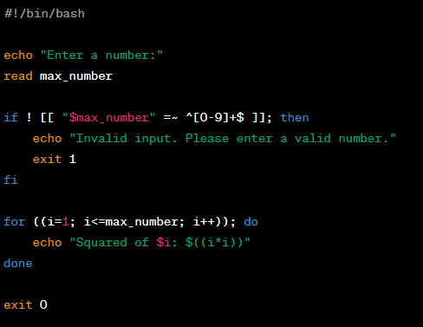
Combining Concepts
You can combine these concepts to create more complex scripts. Here's an example of a script that uses a for loop, user input, and exit status:

Slide 8
Conclusion
In this presentation, we explored the basics of scripting and introduced for loop scripts, do-while scripts, and exit status in scripts. By understanding these concepts, you can automate tasks, process data, and create more efficient and powerful scripts to enhance your productivity.
Remember, scripting is a versatile skill that can greatly simplify repetitive tasks and make complex processes more manageable. With practice and creativity, you can harness the full potential of scripting in various domains.

